Slide 1
ACCIDENT SEVERITY DUE TO EXTERNAL FACTORS
Gaurav Gupta

Slide 2
Introduction
Factors that can contribute to a road crash:
Human factors – the behaviour of the people involved – such as: deliberate risk taking; distraction (mobile phones, music, friends); tiredness (resulting in poor concentration); driving while affected by alcohol or drugs; lateness (resulting in speeding); disregard for road rules; choosing the unsafe option (such as a pedestrian crossing between moving vehicles)
Vehicle factors – features of the vehicle involved – such as poorly maintained vehicle; lack of modern safety features (such as lane assist, brake assist, electronic stability control (ESC), ABS brakes)
Environmental factors – features of the road and surrounding area – such as the surface and condition of the road, and the roadside; poor visibility as a result of heavy rain or bright sunshine; wet roads needing people to travel slower so they have more time to come to a stop; speed limits that make pedestrians and cyclists more vulnerable.

Slide 3
Business Problem & Understanding
Accident Severity prediction is essential as nations, Governments and individuals each want to achieve efficiency in their own domains. Collisions, accidents and damage to property/assets cumulatively are a huge loss for the economy- physically, financially affecting the economy, which strives to achieve and sustain an efficient approach of its resources.
External (which include environmental ) factors, reduce the governments/ corporations efforts to achieve efficiency.
Through the real-time governmental MIS on accident severity, we aim to identify how influential are external/ environmental factors in determining the severity of a collision.

Slide 4
Business Understanding
Attribute | Description | Reasoning
ADDRTYPE | Collision address type:AlleyBlockIntersection | Alleys, blocks and intersections are not under the control of the driver
SEVERITYCODE | A code that corresponds to the severity of the collision:3—fatality2b—serious injury2—injury1—prop damage0—unknown | The attribute which will be finally predicted using our model
COLLISIONTYPE | Collision type | External factors not in control of the driver
WEATHER | A description of the weather conditions duringthe time of the collision. | External factors
ROADCOND | The condition of the road during the collision. | External factors
LIGHTCOND | The light conditions during the collision. | External factors
SPEEDING | Whether or not speeding was a factor in thecollision. (Y/N) | Speeding depends upon the road, environment which is an external factor

Slide 5
Data Wrangling
Data inputs attributed status as “matched” by the Seattle MIS have only been considered and “unmatched” criterias have been removed.
Rows with unknown values in severity code, WEATHER, LIGHTCOND, WEATHERCOND, ROADCOND were dropped
Rows with null values in severity code, addrtype, collision type, weather, roadcond, lightcond have been removed/dropped.
Speeding blank values have been converted to “0” and SPEEDING ‘Y’ values have been converted to 1
Severity Code has been converted to the following numeric codes to convert the dataset into int type.
Severity Code | Description
1 | Property damage
2 | Injury
3 | Fatality
4 | Serious Injury

Slide 6
Data Wrangling
The categorical values of certain parameters have been converted to the following numeric codes
ADDRTYPE | ADDRTYPE CODE
Block | 1
Intersection | 2
Alley | 0
ROADCOND | ROADCONDCODE
Dry | 0
Wet | 7
Ice | 1
Snow/Slush | 5
Other | 3
Standing water | 6
Sand/Mud/Dirt | 4
Oil | 2
WEATHER | WEATHERCODE
Clear | 1
Raining | 6
Overcast | 4
Snowing | 9
Other | 3
Fog/Smog/Smoke | 2
Sleet/Hail/Freezing/Rain | 8
Blowing Sand/Dirt | 0
Severe Crosswind | 7
Partly cloudy | 5
LIGHTCOND | LIGHTCONDCODE
Daylight | 5
Dark-Street Lights On | 2
Dusk | 6
Dawn | 4
Dark-No street lights | 0
Dark-Street lights off | 1
Other | 7
Dark-Unknown Lighting | 3

Slide 7
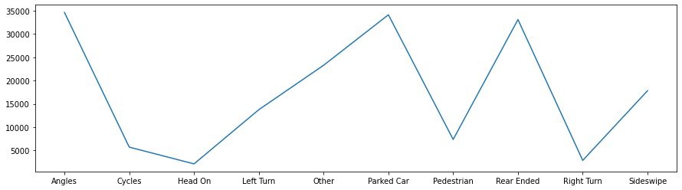
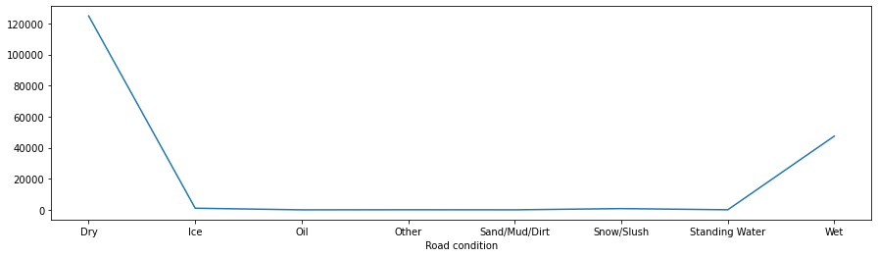
Data Visualization
Most frequent and recorded collision type are those in
Angles
Parked Cars
Rear Ended Collisions
Head-on Collisions are very less
We also understand that from the given dataset, the collisions are more when the roads are dry.

Slide 8
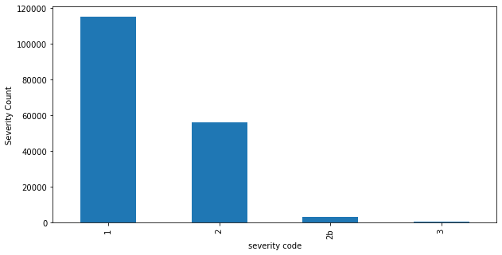
Data Visualization
When considering severity, property damage is considered the most common form of the result of collision.

Slide 9
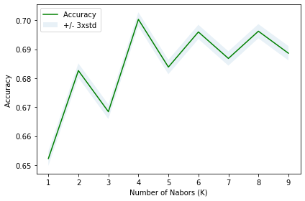
Model Development & Evaluation
For approaching the model development phase, the Support Vector Mechanism of Machine Learning model has been used, alongside with K-Nearest Neighbour
The reasons for choosing them are as follows-
1.Clustering of parameters help us in providing a better scope of understanding and prediction
2.We want to negate outliers as much as possible
3.Large Datasets are more accurate while using KNN.
4.Hence, a clustering based approach is used.

Slide 10
Conclusion
In this study, we analyzed the role of external , environmental effects in influencing the probability of a traffic collision. While as already stated, there are many factors playing a role in identification of collision, external environmental influence is also relevant.
The purpose of this study was to understand how high the influence is, amd whether can we predict the collision by only considering environmental factors.
The answer we get is NO.
Even if government, corporations, individuals ensure that the highways and related traffic is streamlined, efficient. They upgrade their systems and adopt the best of practices. Still, there will be collisions as a probability of 50% is dependant on external factors viz. The Spot of collision, The entities involved in collision, the road, weather, lighting conditions, the clarity, ease of roads which leads to speeding.
Algorithm | Jaccard | F1-score
KNN | 0.52 | 0.65
SVM | 0.47 | 0.58
Algorithm | Jaccard | F1-score
KNN | 0.52 | 0.65
SVM | 0.47 | 0.58

Slide 11
Accuracy of the model
Algorithm | Jaccard | F1-score
KNN | 0.52 | 0.65
SVM | 0.47 | 0.58

